Slide 1

ADVANCED ALGORITHMS

Slide 2

ADVANCED ALGORITHMS
BASICS OF COMPLEXITY

Slide 3
ADVANCED ALGORITHMS
BASICS OF COMPLEXITY
Basics of Complexity - Road Map
Asymptotic Notations
Standard notations and common functions
Recurrences and Solution of Recurrence equations- Substitution method, Recurrence Tree method, Master method
Amortized Complexity Analysis: Aggregate, Accounting and Potential Methods.
NP-Completeness, NP Reduction

Slide 4
ADVANCED ALGORITHMS
BASICS OF COMPLEXITY
Can all computational problems be solved by a computer?
There are computational problems that can not be solved by algorithms even with unlimited time.
For example Turing Halting problem (Given a program and an input, whether the program will eventually halt when run with that input, or will run forever).
Alan Turing proved that general algorithm to solve the halting problem for all possible program-input pairs cannot exist.

Slide 5
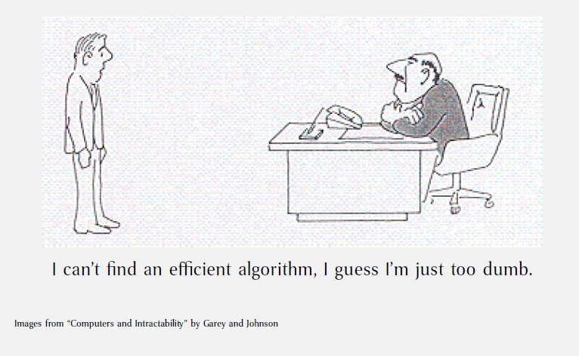
ADVANCED ALGORITHMS
BASICS OF COMPLEXITY
Can all computational problems be solved by a computer?

Slide 6
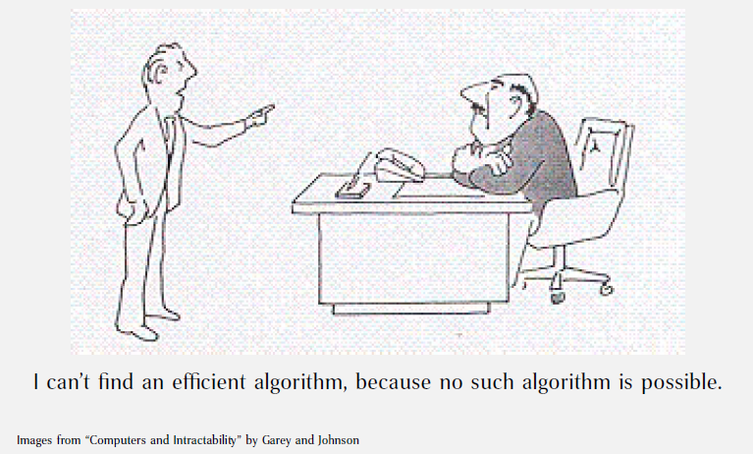
ADVANCED ALGORITHMS
BASICS OF COMPLEXITY
Can all computational problems be solved by a computer?

Slide 7
ADVANCED ALGORITHMS
BASICS OF COMPLEXITY
Unfortunately it is very hard to prove that efficient algorithms are impossible.
Second Best alternative is to show that the problem is as hard as many other problems that have been worked on by a host of brilliant scientists over a long time

Slide 8
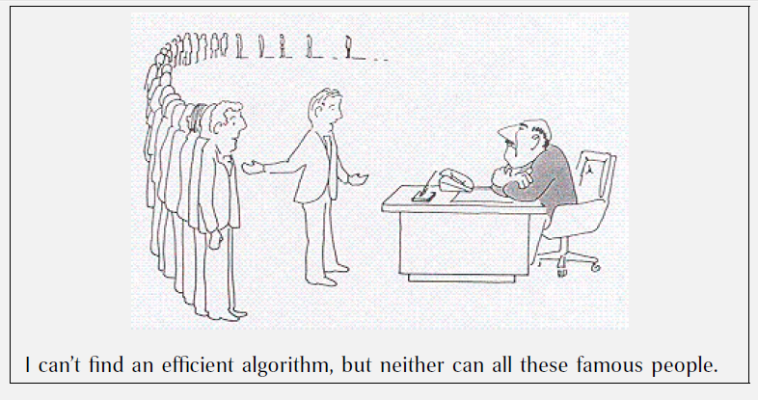
ADVANCED ALGORITHMS
BASICS OF COMPLEXITY
Thanks to cook’s theorem, we can say….

Slide 9
ADVANCED ALGORITHMS
BASICS OF COMPLEXITY
What are NP, P, NP-complete and NP-Hard problems?
P is set of problems that can be solved by a deterministic Turing machine in Polynomial time.
Problems solvable in p-time are considered tractable
Sorting
P
Searching
MST
GCD
Multiplication of large numbers
Graph connectivity
Shortest path

Slide 10
ADVANCED ALGORITHMS
BASICS OF COMPLEXITY
What are NP, P, NP-complete and NP-Hard problems?
P is subset of NP (any problem that can be solved by deterministic machine in polynomial time can also be solved by non-deterministic machine in polynomial time).
Informally, NP is set of decision problems which can be solved by a polynomial time via a “Lucky Algorithm”, a magical algorithm that always makes a right guess among the given set of choices

Slide 11
ADVANCED ALGORITHMS
BASICS OF COMPLEXITY
What are NP, P, NP-complete and NP-Hard problems?
Set Cover
Vertex Cover
NP
TSP
P
3-SAT
Sudoku
K-Clique
Hamiltonian Circuit

Slide 12
ADVANCED ALGORITHMS
BASICS OF COMPLEXITY
What are NP, P, NP-complete and NP-Hard problems?
NP-complete problems are the hardest problems in NP set. A decision problem L is NP-complete if:
1. L is in NP (Any given solution for NP-complete problems can be verified quickly, but there is no efficient known solution). 2. Every problem in NP is reducible to L in polynomial time
Example: Traveling salesman Problem, Hamiltonian Circuit, Graph Isomorphism
NP-complete problems have no known p-time solution, considered intractable

Slide 13
ADVANCED ALGORITHMS
BASICS OF COMPLEXITY
What are NP, P, NP-complete and NP-Hard problems?
NP complete problems are problems whose status is unknown.
No polynomial time algorithm has yet been discovered for any NP complete problem, nor has anybody yet been able to prove that no polynomial-time algorithm exist for any of them.
The interesting part is, if any one of the NP complete problems can be solved in polynomial time, then all of them can be solved.

Slide 14
ADVANCED ALGORITHMS
BASICS OF COMPLEXITY
undecidable
Halting Problem
NP
P
chess
tetris
Problem Space

Slide 15
ADVANCED ALGORITHMS
BASICS OF COMPLEXITY
Solving NP Complete problems?
Approximation: Instead of searching for an optimal solution, search for a solution that is at most a factor from an optimal one.
Randomization: Use randomness to get a faster average running time
Restriction: By restricting the structure of the input (e.g., to planar graphs), faster algorithms are usually possible.
Parameterization: Often there are fast algorithms if certain parameters of the input are fixed.
Heuristic: An algorithm that works "reasonably well" in many cases, but for which there is no proof that it is both always fast and always produces a good result. Metaheuristic approaches are often used.

Slide 16
ADVANCED ALGORITHMS
BASICS OF COMPLEXITY
NP Reduction
Cook-Levin proved that 3-CNF SAT is an NP complete problem.
If a problem X has to be proved NP complete, then reduce 3-CNF SAT problem into X.
This would imply that X is atleast harder than 3-CNF SAT and hence the problem is NP Complete

Slide 17
ADVANCED ALGORITHMS
BASICS OF COMPLEXITY
3 CNF SAT
3 CNF SAT is a special case of satisfiability problem.
(a v b v c) ^ (a’ v b v d) ^ (b’ v c’ v e)….
Find some combination that satisfies the circuit.
This is a NP complete problem

Slide 18
ADVANCED ALGORITHMS
BASICS OF COMPLEXITY
Prove that the problem of finding an independent set of size k is an NP complete problem
Size of k is 3

Slide 19
ADVANCED ALGORITHMS
BASICS OF COMPLEXITY
Max Clique Problem
3 clique

Slide 20
ADVANCED ALGORITHMS
BASICS OF COMPLEXITY
Min Vertex Cover
3 vertex cover

Slide 21
ADVANCED ALGORITHMS
BASICS OF COMPLEXITY
Prove that sum of subset or set cover problem is an NP complete problem using NP reduction

